Slide 1
Online Job Portal
This project explores the design and development of an online job portal designed to connect job seekers and employers efficiently. The portal aims to streamline the recruitment process and provide a user-friendly platform for both parties.

Slide 2
Introduction to Job Portal
Online job portals have revolutionized the recruitment industry by providing a centralized platform for job seekers and employers to connect.
These portals typically offer a range of features such as job search, application tracking, and employer profiles.
A well-designed job portal prioritizes user experience, offering an intuitive interface and efficient functionality.
The system boasts a wide range of job opportunities across various industries and locations.

Slide 3
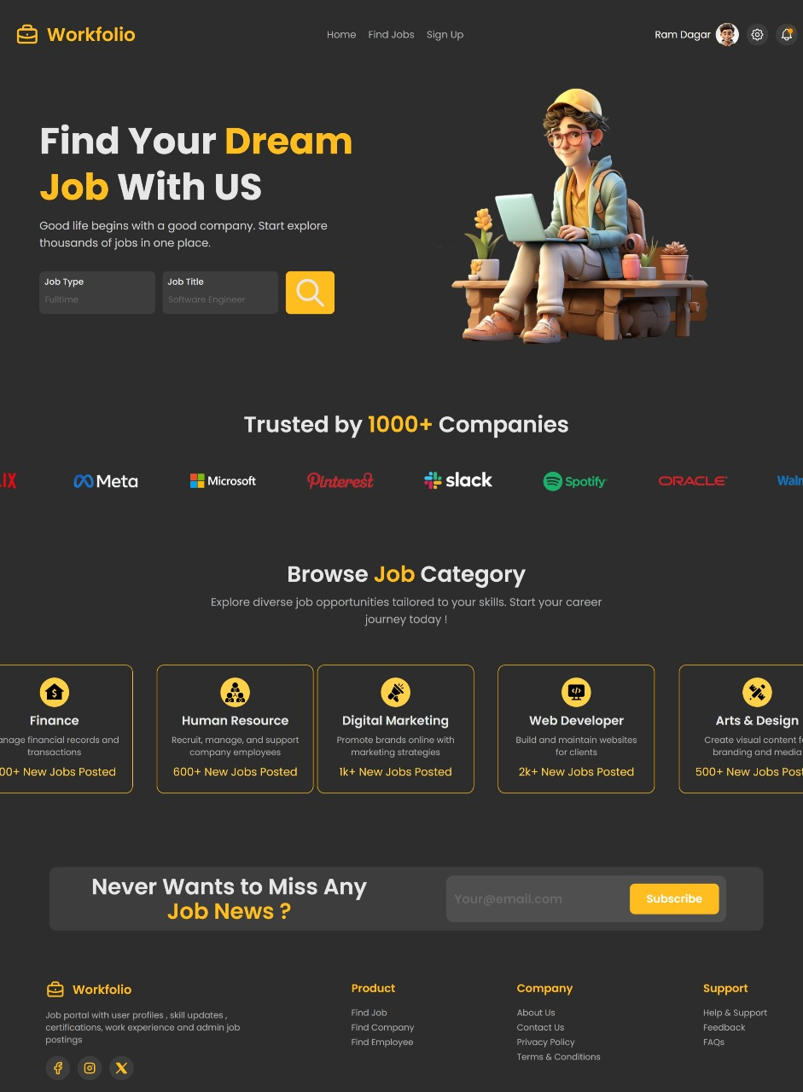
Project Overview
1
Requirement Gathering
Understanding the needs of both job seekers and employers to define key functionalities and features.
2
Design and Development
Creating a user-friendly interface, implementing database management, and integrating relevant search functionalities.
3
Testing and Deployment
Rigorous testing to ensure the portal's functionality and user experience, followed by deployment to the live environment.

Slide 4
User Features
1
Register and Create Profile
2
Update Profile Information
3
View Job Vacancies
4
Apply For Positions
5
Receive Notifications

Slide 5
Technology Stack
Frontend Technologies
Backend Technologies
Database Technologies
ReactJS
Java Spring Boot Framework
MongoDB
Frontend framework for building a dynamic and responsive user interface.
Backend framework using Java for building robust and scalable server-side logic and microservices/APIs.
NoSQL database used for storing and managing application data efficiently.
TypeScript Mantine Core
Framework used for building type-safe and maintainable frontend code. Provides a set of ready-to-use components.
CSS
Styling language used to enhance the visual appeal and responsiveness of the frontend.

Slide 6


Milestones
User Authentication and Registration
Graduates can securely register, log in, and manage their job availability with email verification and password reset for account security. This enables relevant job matching based on updated availability.
Job Availability Management
Administrators manage user verification for account security and maintain job availability data through the Job Management Interface. This ensures accuracy and upholds platform integrity. Here all jobs available on the platform are shown

Slide 7

Milestones
Job Information Management
Design and develop the interface for submitting application. Implement functionality for users to select Job, and upload their personal detail, qualifications and skills also and submit to company. Connect database with backend so that user registration details and applicant form submission can be stored and user can also retrieve their account by forgetting password.
Mock Test
4
Design mock test page so that user can take demo of final examination or test for that job it involves question related to skill required in job
4

Slide 8
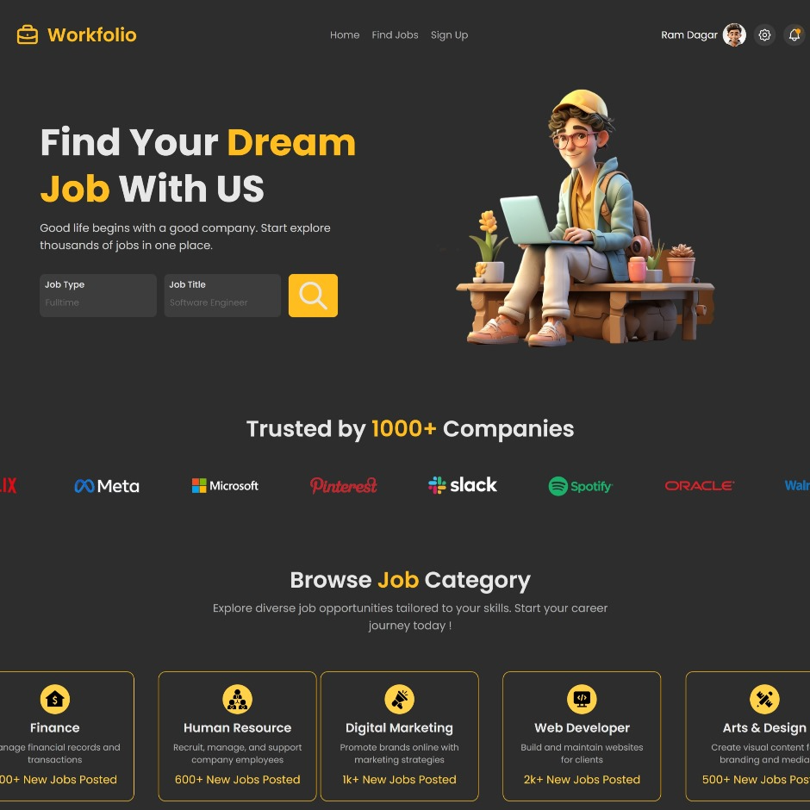
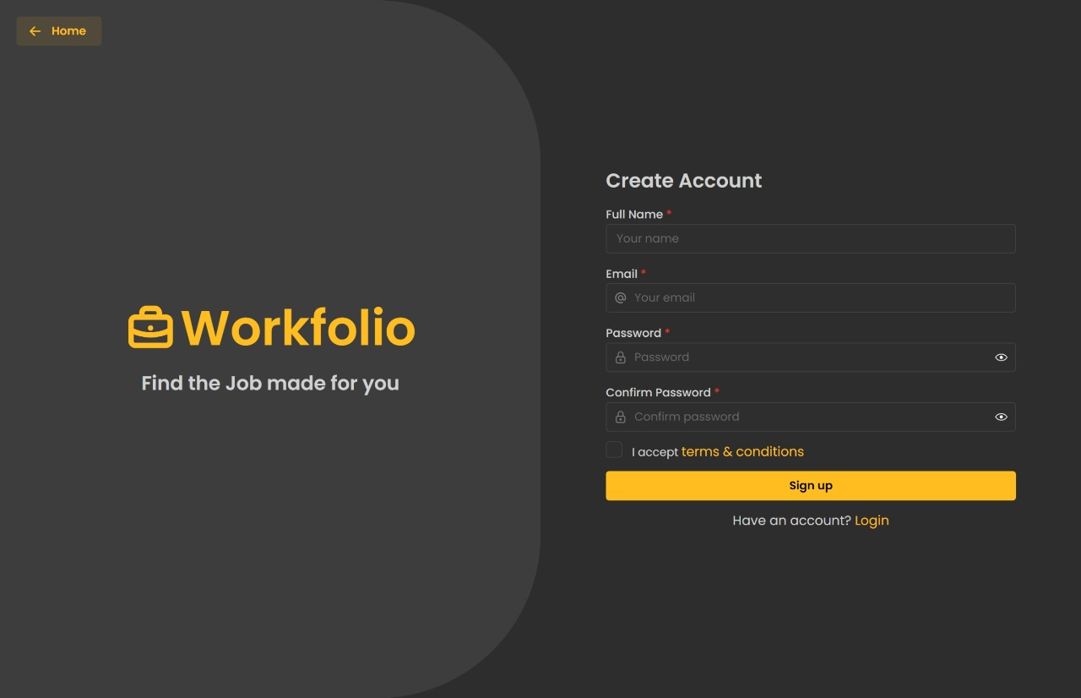
Home Page
Registration Page

Slide 9
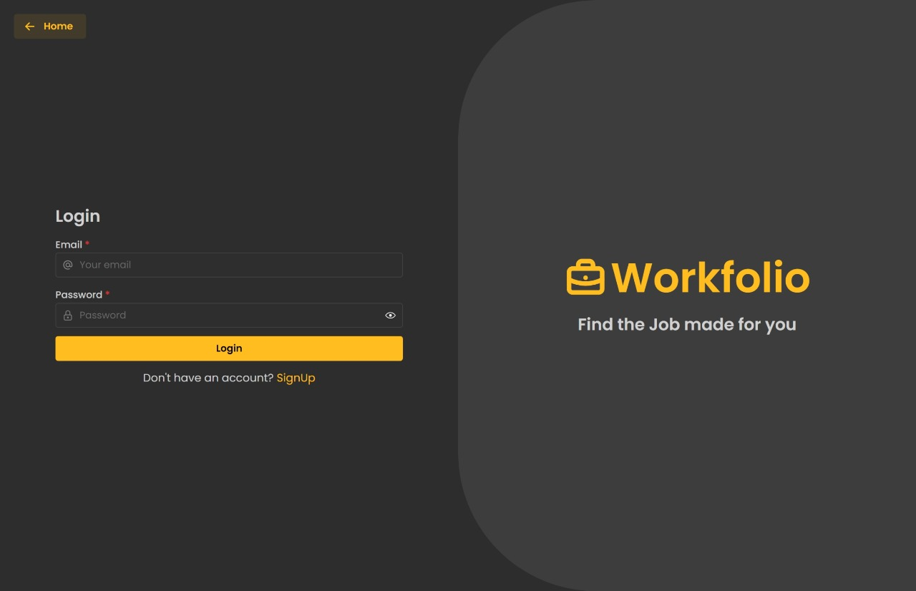
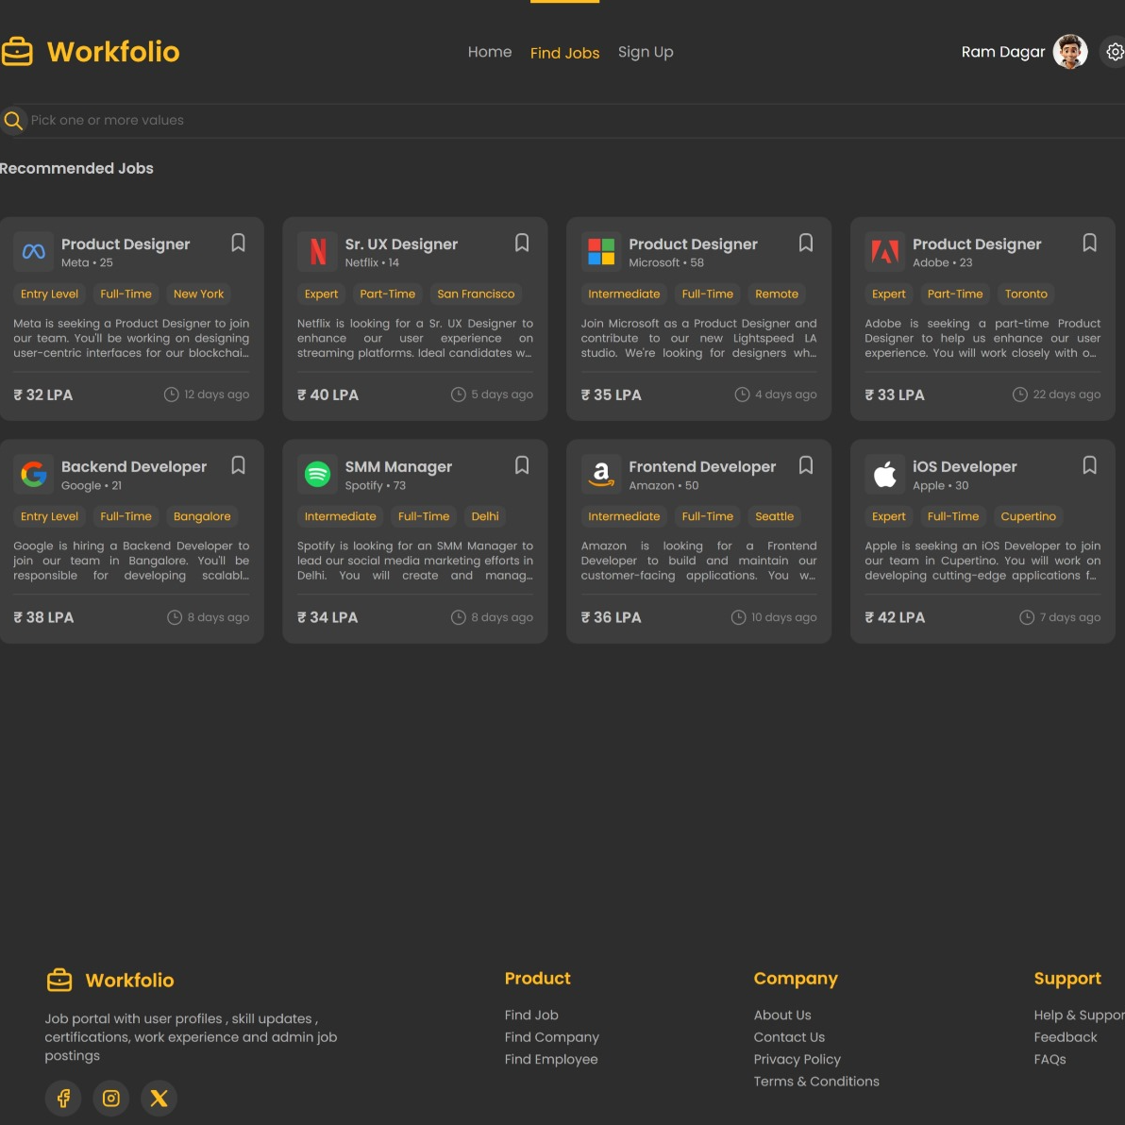
Login Page
Job Searching Page

Slide 10
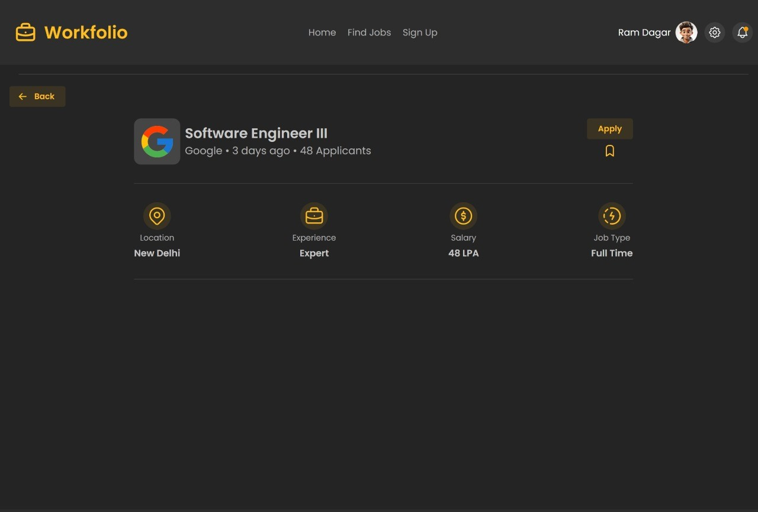
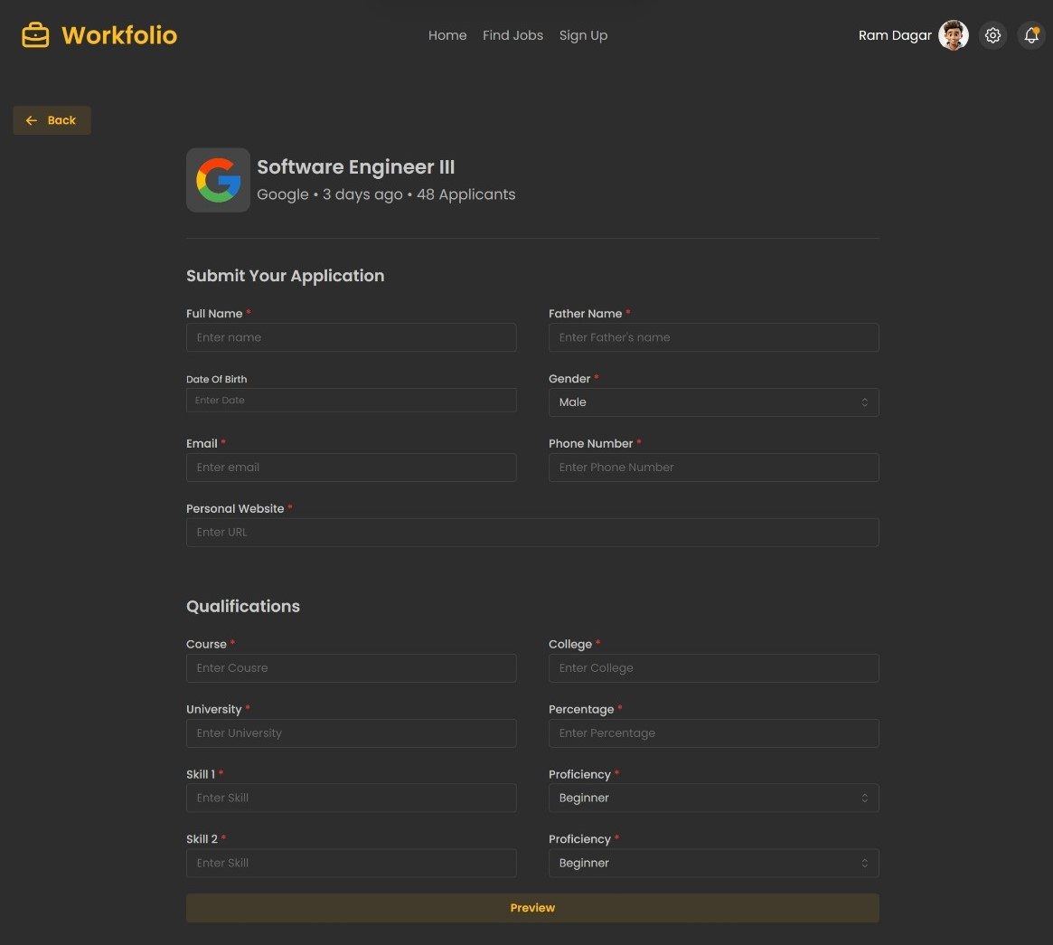
Job Description Page
Job Application Page

Slide 11
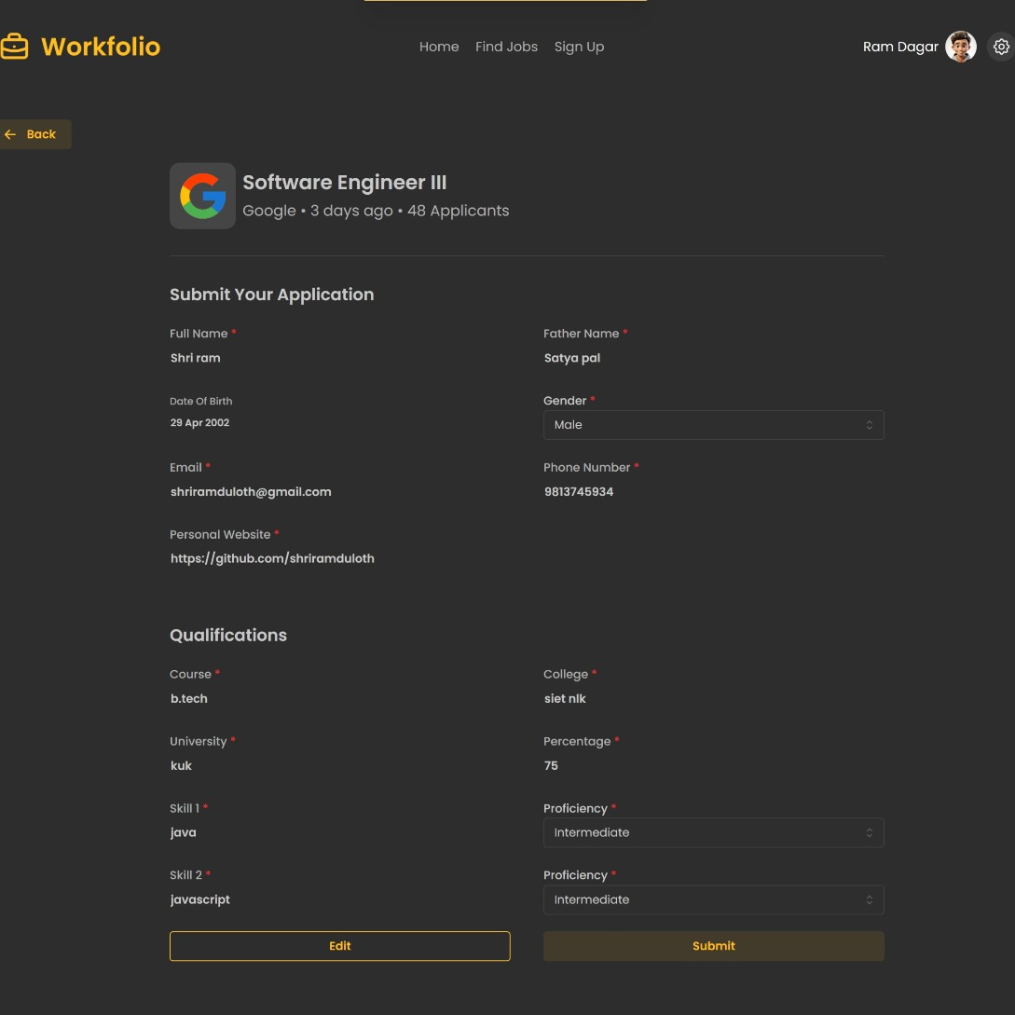
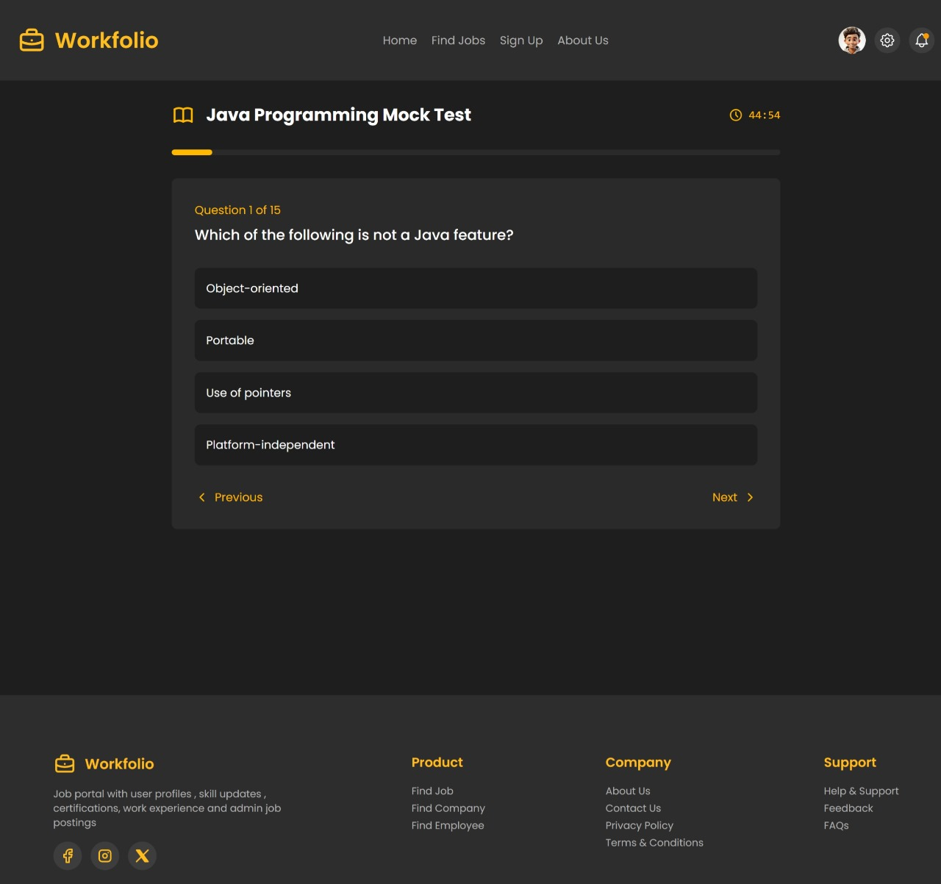
Application Preview Page
Mock Test Page

Slide 12
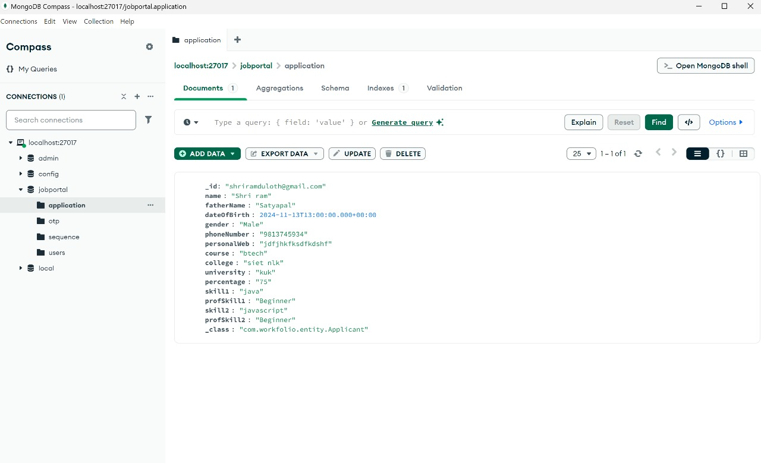
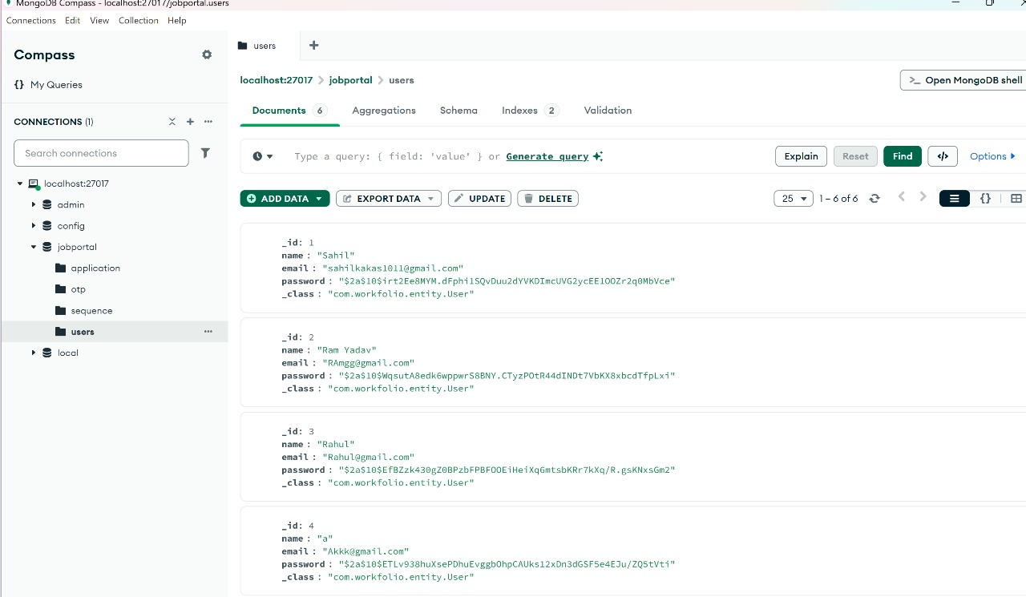
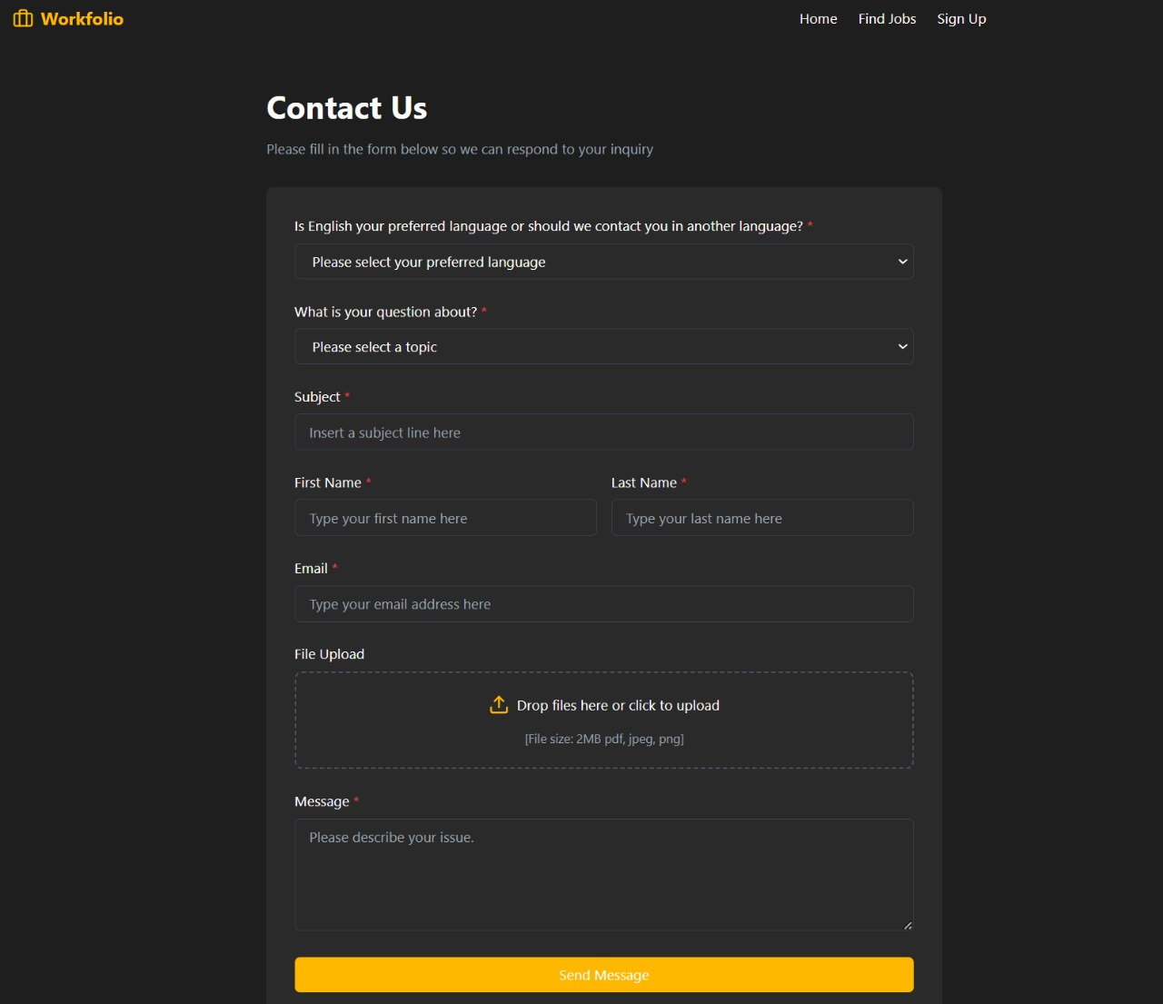
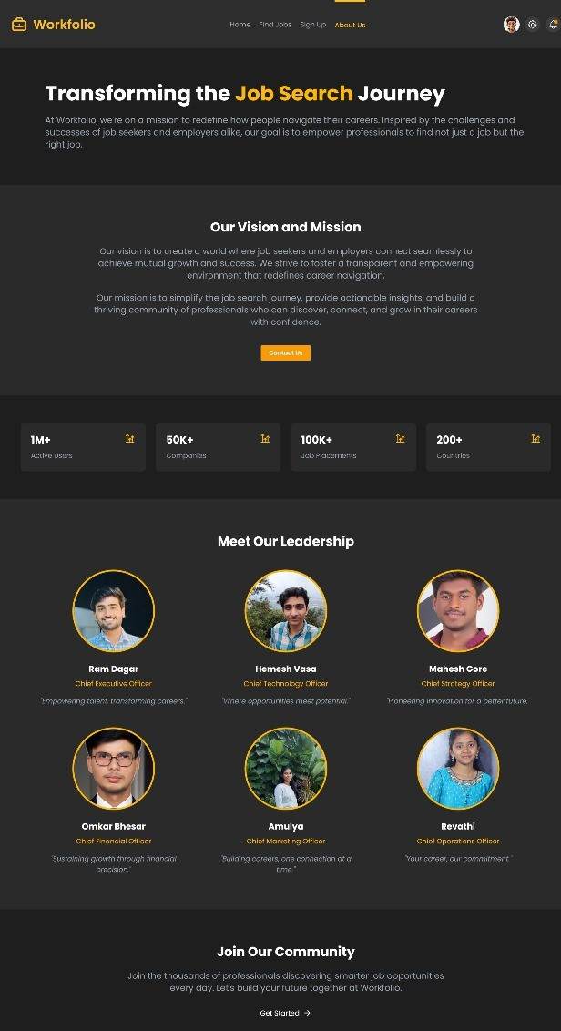
Database Images
Job Application Database
User Registration Database
Contact Us Page
About Us Page

Slide 13
Conclusion and Future Roadmap
Project Completion
The online job portal will be a valuable resource for connecting job seekers and employers.
Future Enhancements
Continued development, including advanced search features, AI-powered matching, and integration with social media platforms.
Impact
The project aims to contribute to a smoother and more efficient recruitment process for all stakeholders.

Slide 14
Team Members
1
Omkar Bhesar
2
Ram Dagar
3
Hemesh Vasa
4
Mahesh Gore
5
Gogu Revathi
6
Kokkula Amulya

Slide 15
THANK YOU !

